Slide 1
Ionization energy and electron configuration

Slide 2
Ionization energy
How much energy it takes to remove an electron
The smaller the size of the atom the higher the ionization energy
Ionization energy decreases down a group
Ionization energy increases across a period

Slide 3
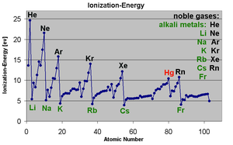
Noble gasses have the highest ionization energy
Alkali metals have the lowest

Slide 4
If the ionization energy is high the atom is stable
If low the atom is not stable
Which period three element is most stable? Least?

Slide 5
Second ionization energy
How much energy it takes to remove the second electron
Always is more then the 1st ionization energy
Follows the same pattern

Slide 6
Electron configuration
Tells where the electrons are
There are two important parts
Energy level (a number)
And sublevel (a letter)

Slide 7
Each energy level has different amounts of sublevels
1=only s
2=s and p
3=s,p,d
4=s,p,d,f
Sublevels hold different amounts of electrons
S=2
P=6
D=10
F=14

Slide 8
Order
Electrons fill in this order:
1s, 2s, 2p, 3s, 3p, 4s, 3d, 4p, 5s, 4d, 5p, 6s, 4f, 5d, 6p, 7s, 5f, 6d, 7p
Atomic number is total number of electrons!
Ex:
C=6
1s² 2s² 2p²

Slide 9
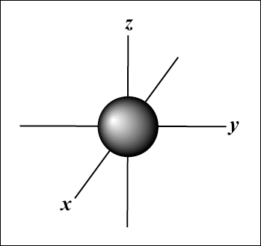
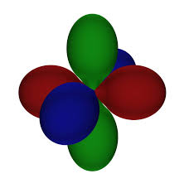
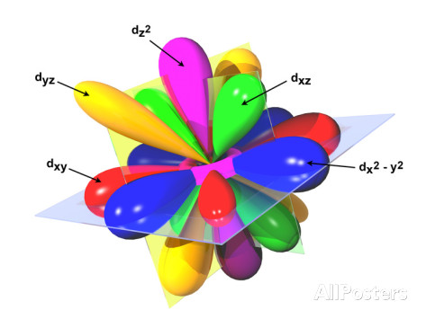
S orbital P orbitals
D orbitals F orbitals

Slide 10
Review electron configuration
What is the electron configuration for:
Sulfur
Strontium
Iodine

Slide 11
Ions
When an element has a charge it is called an ion
Ions are formed by gaining or loosing electrons
Positive ions have lost electrons equal to charge
Negative ions have gained electrons equal to charge

Slide 12
How many electrons
Ca²⁺
Si⁴⁻
Ga³⁺
O²⁻

Slide 13
Electron configuration for ions
Follow the same order as for a neutral element. Just add up to the new amount of electrons
Fe³⁺
Br¹⁻

