Slide 1
Communication

Slide 2
Why is communication important? (know 2)
So we can better understand others
So we can get what we want
Shows respect for others
We are more productive and successful
To help resolve conflict

Slide 3
Communication…
Is what we do to give and get understanding
It is the process of sending and receiving messages

Slide 4
What are some ways that we communicate?
Verbal: using words
Non-verbal
Facial expressions, body language, text, or written

Slide 5
Misunderstandings
Have you ever had a misunderstanding that could have been prevented if someone communicate more effectively?
Examples?
Telephone
Did the message get lost or change as it moved around the room?
Does this ever happen with rumors/school gossip?

Slide 6
Charades
I need a volunteer… who is ok getting up in front of the class to act something out
How did our “actors” communicate when they couldn’t talk?
Was the message delivered in a way you could understand?
We communicate all day long with our body language.
Can you tell when your friends, parents, teachers are having a good or bad day? With just looking at their body language?

Slide 7
Communicate with just verbal communication
I’m looking for a volunteer to tell a story without using any non-verbal communication.
When/if you see non-verbal communication raise your hand

Slide 8
Skills for effective communication (www.helpguide.org) (Know 3)
Become an engaged listener
Pay attention to nonverbal signals
Keep stress in check
Assert yourself

Slide 9
Become an engaged listener
Effective communication is less about talking and more about listening
Focus fully on the speaker
Body language, tone of voice, and other nonverbal cues
Avoid interrupting or trying to redirect the conversation to your concerns
Show your interest in what’s being said
Nod, smile, use active listening skills
Provide feedback
Paraphrase

Slide 10
Pay attention to nonverbal signals
Nonverbal communication includes: facial expressions, body movement and gestures, eye contact, posture, the tone of your voice, and muscle tension

Slide 11
Tips for improving how you read nonverbal communication
Be aware of individual differences
People can have different body language depending on age, culture, religion, gender, and mental state
Look at nonverbal communication signals as a group
Consider the signals as a “whole” to get a better idea of what someone is saying

Slide 12
Tips for improving how you deliver nonverbal communication
Make sure your nonverbal and verbal match
Adjust your nonverbal signals according to your context
Know your “audience”
Use body language to convey positive feelings

Slide 13
Video showing the importance of body language
Video

Slide 14
Keep stress in check
Know what your “warning lights” are
Take deep breath and pause if needed
See if you can find humor in the situation
Be willing to compromise
Agree to disagree
What do you do to manage your stress?

Slide 15
Assert yourself
Express your thoughts, feelings, and needs in an open and honest way while standing up for yourself.
Positive assertive skills:
Value yourself and your opinions
Know your needs and wants
Express negative thoughts in a positive way
Learn to say No

Slide 16
Conflict…
What is your definition of conflict?
an ​active ​disagreement, as between ​opposing ​opinions or ​needs
Raise your hand if you’ve ever had to deal with conflict…
What are some common causes of conflict for a 7th grader?

Slide 17
What feelings do you have that go along with conflict?
Angry, jealous, lonely, scared, confused, disappointed, worried, sad, overwhelmed, hopeless, frustrated?

Slide 18
When we are involved…
In a disagreement or conflict, we have a choice in how we react and behave
Every choice we make has a consequence (positive or negative)

Slide 19
Learning abut conflict resolution
Can help keep you safe from violence, make you feel good about yourself, help you learn to respect others, and may help you get what you want

Slide 20
Consequences of conflict
What do you think?
Can get dangerous, problems don’t improve, confusion, conflict may get worse, stress, and hurts relationships

Slide 21
Positive consequences of conflict
Happiness, stronger relationships, learn about others, positive changes, feeling positive, feeling heard and that your viewpoint is important

Slide 22
How do you deal with conflict?
What works best for you?
What doesn’t work for you?

Slide 23
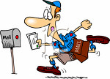
Tips to successfully resolve conflict
Know 3
Talk to the person directly, don’t use a “mailman.”
Don’t jump to conclusions
Hearing the other side of the story can help you get the facts and understand where they are coming from
Listen!!!
Be an active listener

Slide 24
Tips continued…
Use “I” statements
Begin your statements with “I,” not “You”
Don’t be afraid to apologize
Think of ideas of ways you can prevent this from happening again

Slide 25
Tips continued some more… ☺
Remain calm
Let the other person do the talking
Really try to see the other person’s point of view
If it becomes verbally abusive, put a stop to it

Slide 26
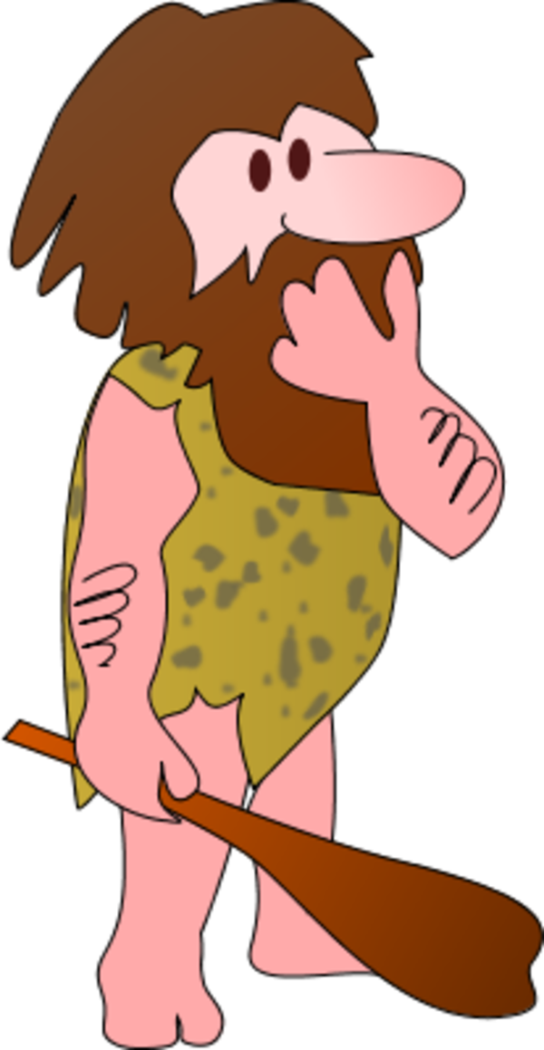
More…
Analyze the conflict
What triggered the conflict
Who are you angry with
What are you not getting that you want?
How can the conflict be resolved?

Slide 27
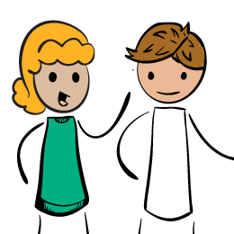
And some more…
Agree to disagree
Focus on the future
Maintain confidentiality
Try to avoid venting to people outside of the situation
Do your part to prevent rumors

Slide 28
Scenarios… What can we do?
“I was sitting here first”
Sarah was sitting in a chair but got up to use the bathroom. When she came back, Dana was sitting in that seat. Sarah wants her seat back and Dana doesn’t want to give it up.
What can be done?

Slide 29
“I heard you didn’t like me!”
Jenny overhears a group of girls making fun of the outfit she is wearing today. She notices that Lauren, a girl who has teased her about her clothes before, is part of that group. Jenny feels like crying.
What can be done?

Slide 30
“That’s Mine!”
Jolie and Carrie are sitting next to each other eating a snack. When Jolie turns to talk to another friend, Carrie grabs Jolie’s snack and hides it in her lap. Jolie turns back and notices her snack is gone and suspects that Carrie stole it.
What can be done?

