Slide 1
Atomic spectra
10/2/14

Slide 2
The Dual Nature of Light: The Particle and The Wave
• Ancient Greeks people thought of light as a stream of tiny particles -like marbles or billiard balls
• Thomas Young (in 1807) performed the now classic double slit experiment showed a diffraction pattern -- light is a wave

Slide 3
The Dual Nature of Light
• Wavelength (λ) is the distance light
travels in one cycle.
• Frequency ( ) is the number of wave
cycles completed each second.
• Amplitude is the height measured from
the center of the wave.

Slide 4
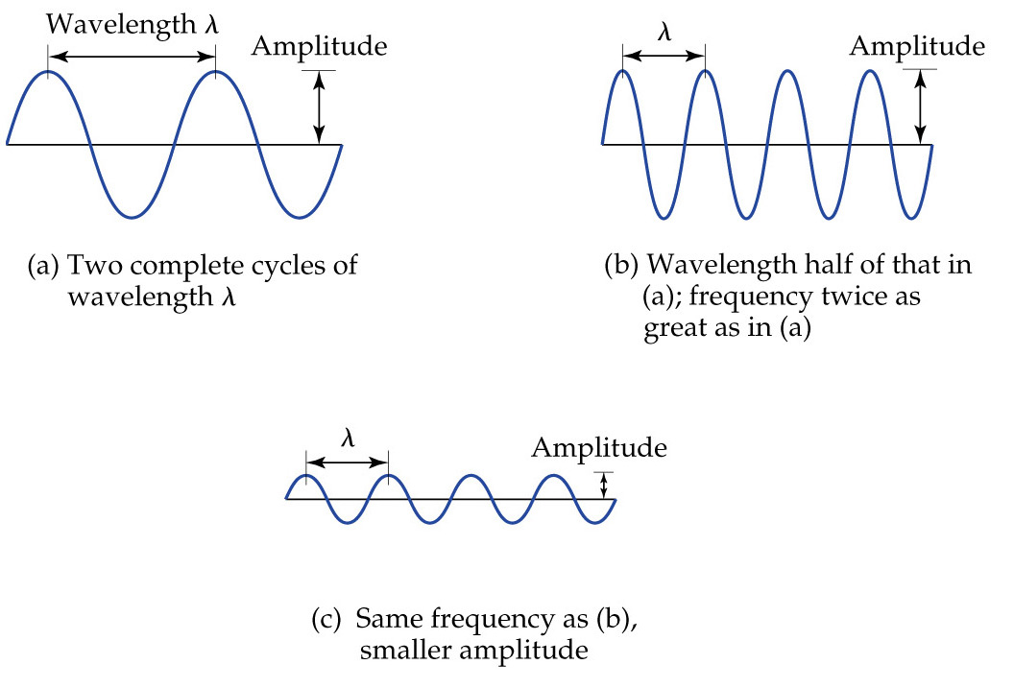
Wave Properties

Slide 5
The Wave Nature of Light
Speed of a light, c, is given by its frequency multiplied by its wavelength:
speed of light = c = 3.00x10⁸ m s⁻¹

Slide 6
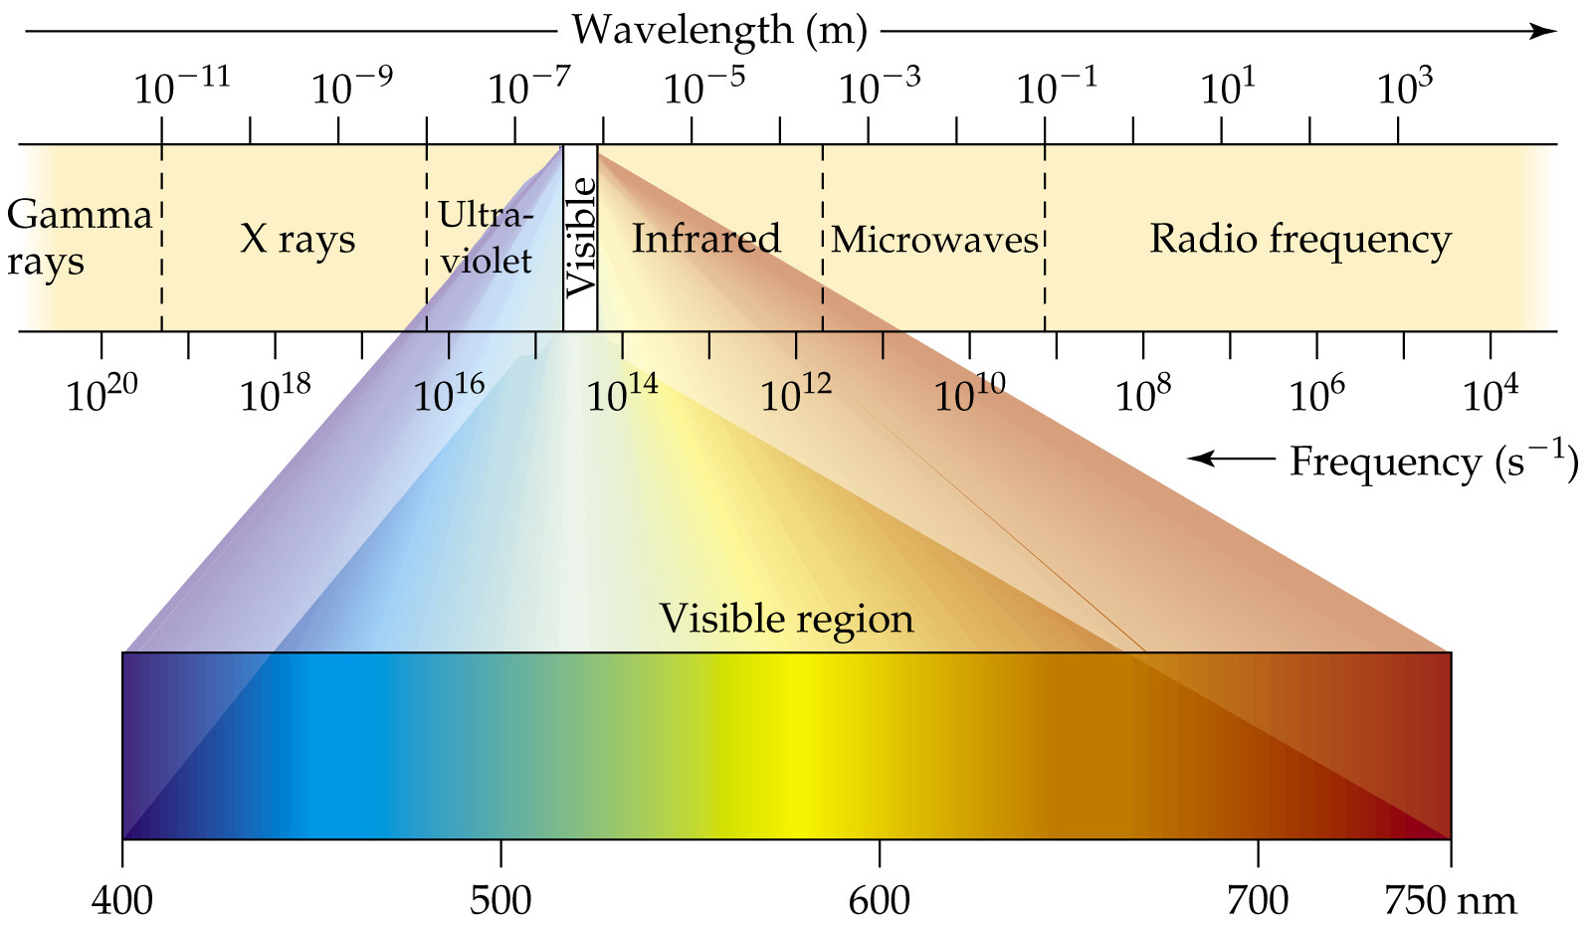
The Wave Nature of Light

Slide 7
Frequency - Wavelength
The red light in a laser pointer comes from a
diode laser that has a wavelength of about 632
nm. What is the frequency of the light? 1m=10⁶nm

Slide 8
Quantized energy
Planck: energy can be absorbed or released from atoms in particles called quanta or photons
The energy of one photon is
E=
h=6.626 x 10⁻³⁴ J s

Slide 9
Energy of Emission
For red light with a wavelength of about 632
nm, what is the energy of a single photon? 1m=10⁶nm

Slide 10
The Bohr Model of the Atom
e- can only exist in certain discrete orbits
Electrons moving from a higher to a lower state create different colors of light
Higher energy is violet
lower energy is red
http://www.mhhe.com/physsci/astronomy/applets/Bohr/applet_files/Bohr.html

Slide 11
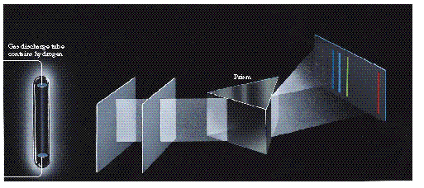
The Atomic Spectra
Heated elements emit a light spectra when focused through a prism
H
• Each element has its own, unique spectrum
Hg
Ne

