Slide 1
Atomic History
10/5/15

Slide 2
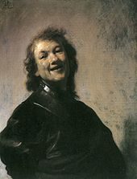
Democritus Theories
~400BC
·The first known idea of the atom was proposed by this Greek philosopher
·According to Democritus, all matter was made up of small indivisible particles he called atoms.
·He was known as “The Laughing Philosopher” because most people believed he was insane

Slide 3
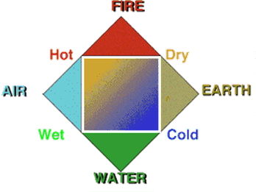
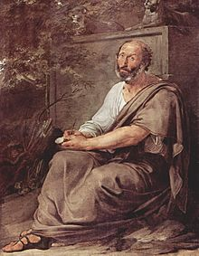
Aristotle Theories
~300BC
·Aristotle believed that all substances were made of the four elements—fire, air, earth, and water.
·all materials were made of atoms with the exception of God.
·No exact date is given

Slide 4
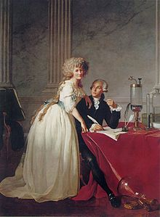
Antoine Lavoisier
1777-Discovered that law of conservation of mass
Burned substances in a controlled area and measured the mass before and after including the gases produced
Was beheaded during the French revolution

Slide 5
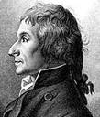
Joseph Proust
1798 wrote the law of definite proportions:
Compounds always have the same amount of each element. Different ratios of elements in a compound make different substances

Slide 6
John Dalton Theories
1808
Dalton's 5 points:
·All matter is made of atoms. Atoms are indivisible and indestructible.
·All atoms of a given element are identical in mass and properties.
·each element has a different type of atom with different masses and properties
·Compounds are formed by a combination of two or more different kinds of atoms.
·A chemical reaction is a rearrangement of atoms.

Slide 7
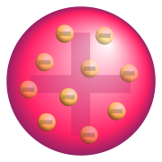
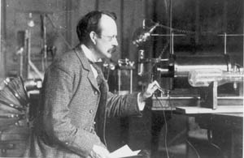
Thomson's discovery
·1890 JJ Thomson-discovered electrons (negative charges) using cathode ray tube.
·Created a model of the atom called plum pudding
·Electrons have very close to zero mass
http://highered.mcgraw-hill.com/sites/0072512644/student_view0/chapter2/animations_center.html#

Slide 8
RA Millikan
1917 Millikan measured the exact charge and mass of an electron by suspending charged drops of oil
http://highered.mcgraw-hill.com/sites/0072512644/student_view0/chapter2/animations_center.html#

Slide 9
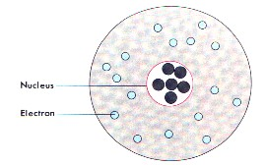
Rutherford's discovery
·1911- Rutherford proved positive particles existed and were held in a central core which he called “nucleus”
·Most of the atom is empty space except for the nucleus that contains most of the mass
http://phet.colorado.edu/simulations/sims.php?sim=Rutherford_Scattering

Slide 10
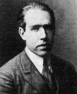
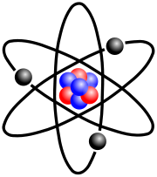
Bohr's Model
Bohr said electrons located outside the nucleus could only be located in specific paths called orbitals.
This was supported by the line spectra of atoms
His model is called the planetary model
http://www.mhhe.com/physsci/astronomy/applets/Bohr/applet_files/Bohr.html

Slide 11
Chadwick's Discovery
1932- Chadwick discovered the neutron (also located in the nucleus)
Used a Geiger counter to detect radiation from neutrons
Neutron's have no charge but about the same mass as a proton.

Slide 12
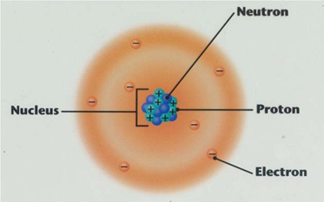
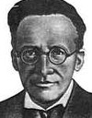
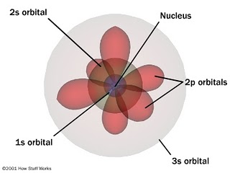
Schrodinger's Model
·1935- Schrodinger proposed Electron Cloud Theory - basic difference being that the electrons are found in "probable" locations outside the nucleus on energy levels and that the atom is mostly empty space
·Based on quantum theory
·Used for advanced calculations only

Slide 13
Numbers on the periodic table
9/29/14

Slide 14
Subatomic particles
Particle | Location | Charge | Mass (amu)
Proton | Nucleus | + | 1
Electron | Orbital's | - | 0
Neutron | Nucleus | 0 | 1

Slide 15
Numbers
Atomic number: whole number that tells the number of protons
Mass number: Tells the mass of the element. Equal to protons plus neutrons
Average atomic mass: decimal on periodic table that tells the average mass of all of those elements in the world

Slide 16
Symbols
Mass number Element symbol
Atomic number Charge

Slide 17
Finding particles
Protons=atomic number
Electrons=atomic number - charge
Neutrons=mass number- atomic number

Slide 18
He
Li
#p = _____
#n = _____
#e = _____
#p = _____
#n = _____
#e = _____
O⁻²
_____
#p = _____
#n = _____
#e = _____
5
#p = _____
#n = _____
#e = _____

